Slide 1
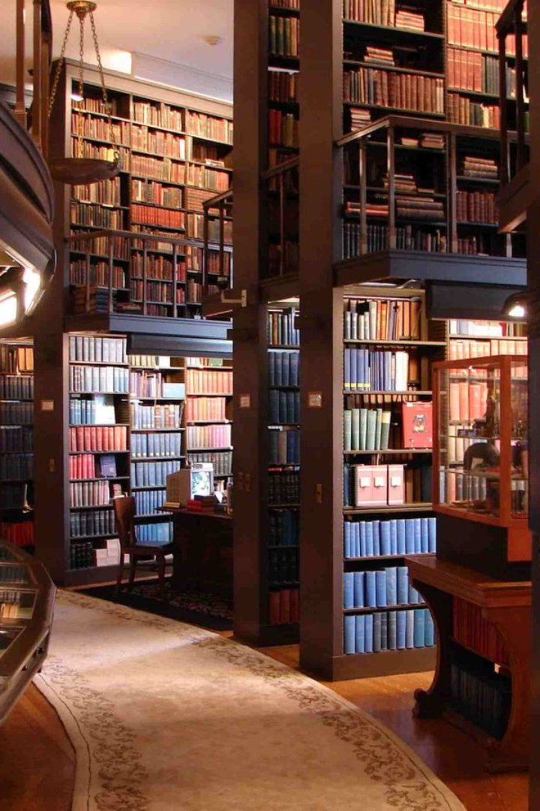
Library Management System

Slide 2

Introduction
Let's begin by understanding the importance of a robust Library Management System (LMS) in the digital age. Explore how an OLMS improves accessibility, enhances user experience, and streamlines administrative processes.
Objective:
The main goal is to revolutionize traditional library operations, providing an advanced and efficient experience for both library staff and users.
Overview
Transformational Impact: OLMS represents a significant shift in library operations, seamlessly integrating tools to enhance overall efficiency.
Functionalities: Encompasses user registration, book organization, digital access facilitation, and intelligent data management.

Slide 3

Users and User Objectives
Librarians 📚
Patrons 📖
Efficiently manage library resources, automate check-in and check-out processes, and provide a seamless user experience.
Search and reserve books easily, receive notifications for due dates and availability, and access personalized reading recommendations.
Administrators 💼
Generate comprehensive reports, monitor inventory, analyze user data, and optimize library operations for better decision-making.

Slide 4




Functional Requirements
Data Storage and Management
User Management
The system securely stores a variety of library data, ensuring organized and confidential storage. Data privacy is maintained through encryption and secure procedures.
Streamlined processes for user registration, profile updates, and account management optimize efficiency. The system supports role-based access controls, customizing functionalities for patrons, librarians, and administrators
Resource Management
Search and Reservation
The system offers a comprehensive suite for managing library resources, including intuitive interfaces for cataloging, streamlined check-out, return workflows, and robust tracking of resource locations and availability.
Users benefit from a swift resource search using diverse filters and keywords through an advanced search engine. The reservation system allows users to reserve items, join waitlists, and receive real-time updates on status changes.

Slide 5




Notifications and Alerts
Reporting and Analytics
Automated notifications for due dates, reservations, and library updates are efficiently dispatched by the system. Users have the flexibility to customize notification preferences, selecting preferred alerts and delivery methods such as email or SMS.
Library staff access comprehensive reporting tools providing detailed insights into library usage, resource popularity, and user activities. The analytics module tracks key performance indicators, presenting data trends to support informed decision-making.
Accessibility Features
Mobile Accessibility
Inclusive design adheres to accessibility best practices, ensuring usability for individuals with disabilities. Key features include screen reader compatibility, alternative text for images, and user interface options catering to users with limited capability.
The system ensures core functionalities are accessible on various mobile devices through a mobile application or responsive design. Prioritizing ease of navigation and quick access to essential services, it offers a seamless user experience across devices.

Slide 6


Integration with External Systems
User Role Management
The system seamlessly integrates with external databases, educational platforms, and third-party systems for a smooth integration experience. It establishes APIs and data exchange protocols to enhance the library’s resource network and service offerings.
The system uses precise mechanisms to specify permissions for different user roles.
Settings enable or restrict actions, providing fine-tuned control over resources, users, and system configuration.

Slide 7
User Interface
Intuitive Design 🎨
Responsive Layout 📱
Enjoy a clean and user-friendly interface that allows users to navigate seamlessly, search for books effortlessly, and perform tasks with ease.
Access the Library Management System from any device - desktop, tablet, or mobile - ensuring a consistent and optimized experience across all platforms.

Slide 8
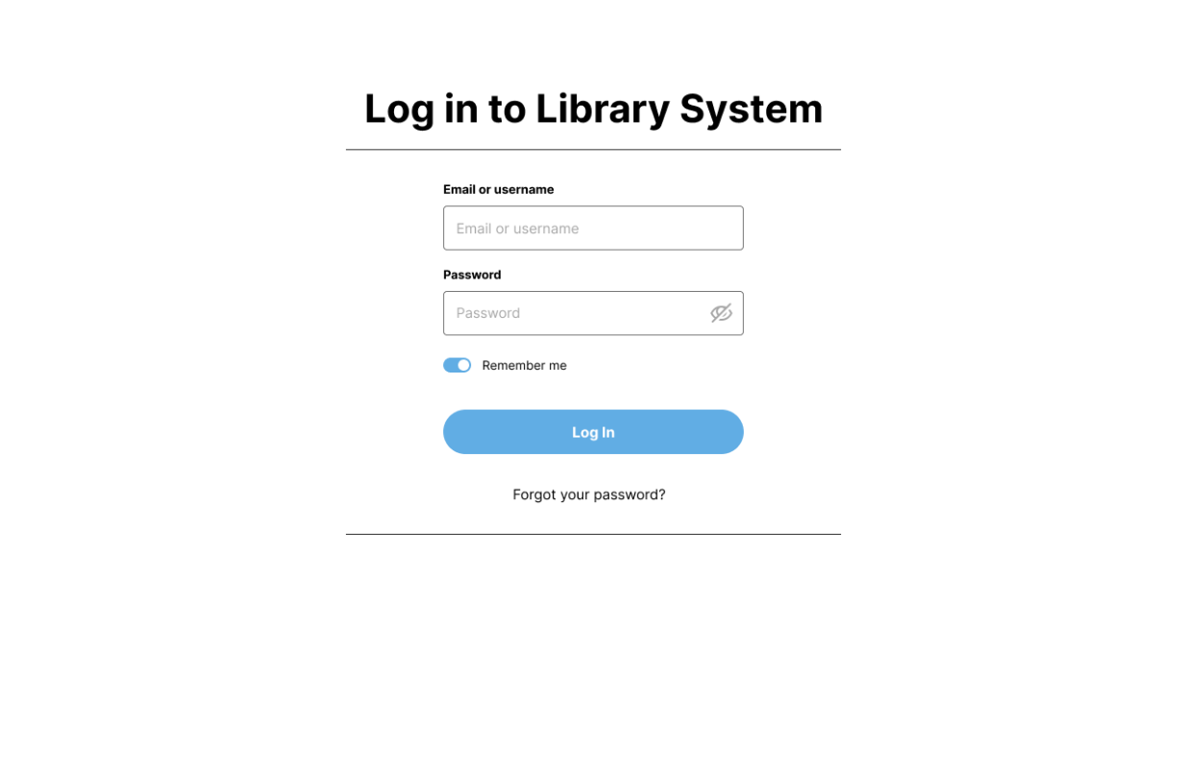
Login Page

Slide 9
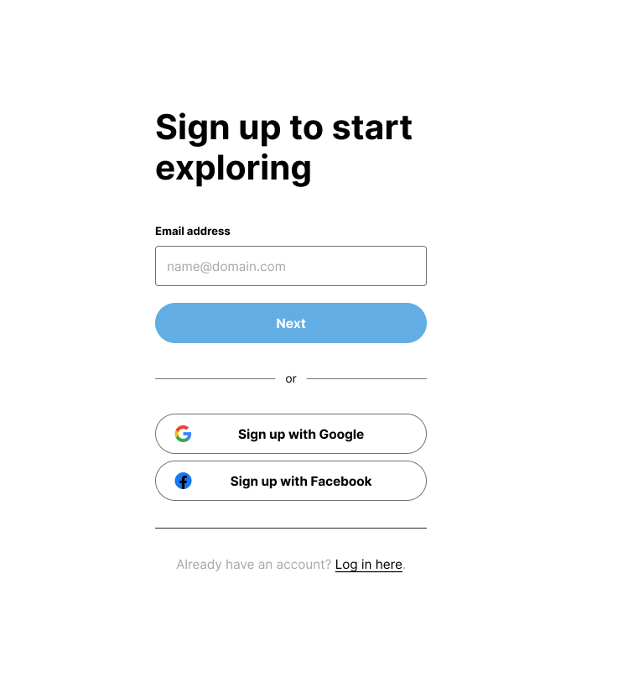
Sign-Up Page

Slide 10
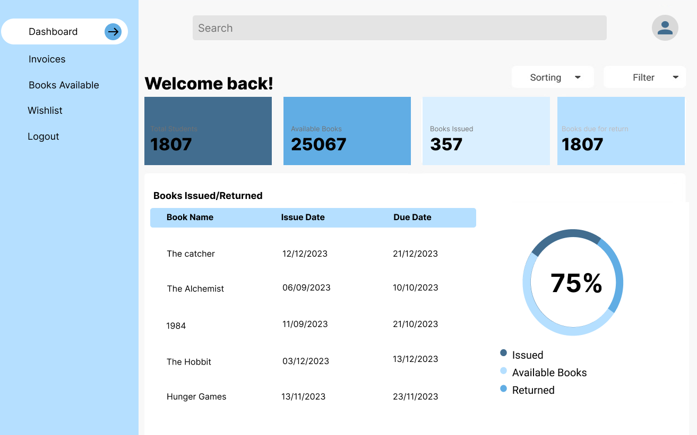
Landing Page

Slide 11
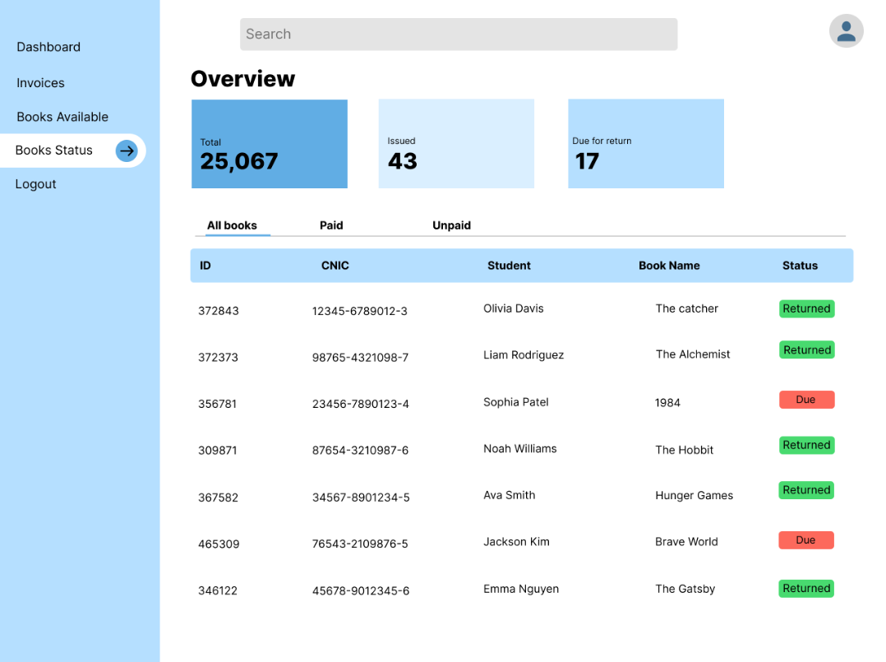
Fine Management

Slide 12

Book Status

Slide 13
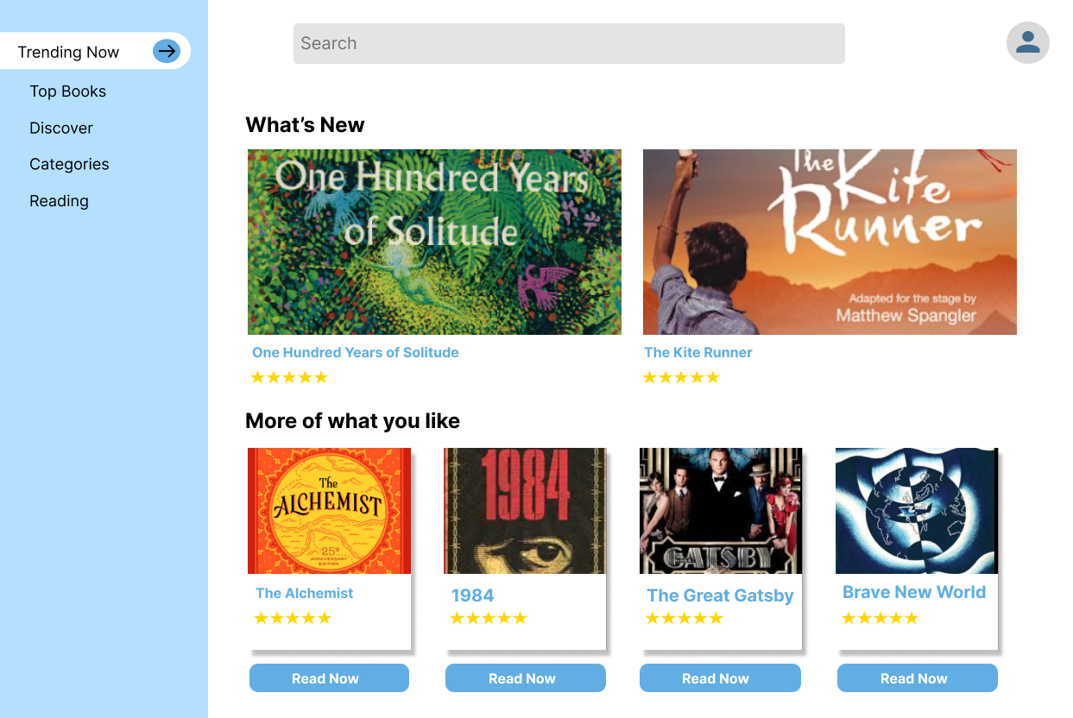
eBooks

Slide 14
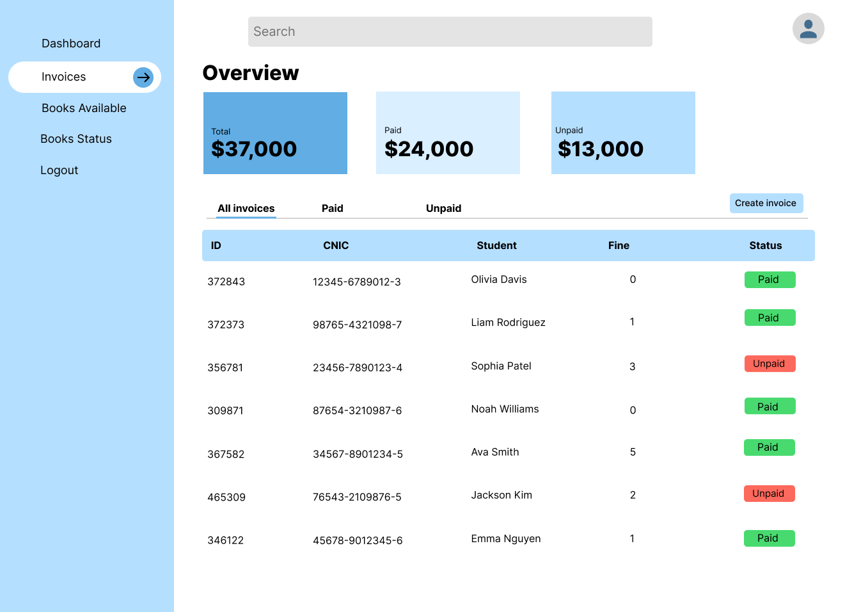
Fine

Slide 15
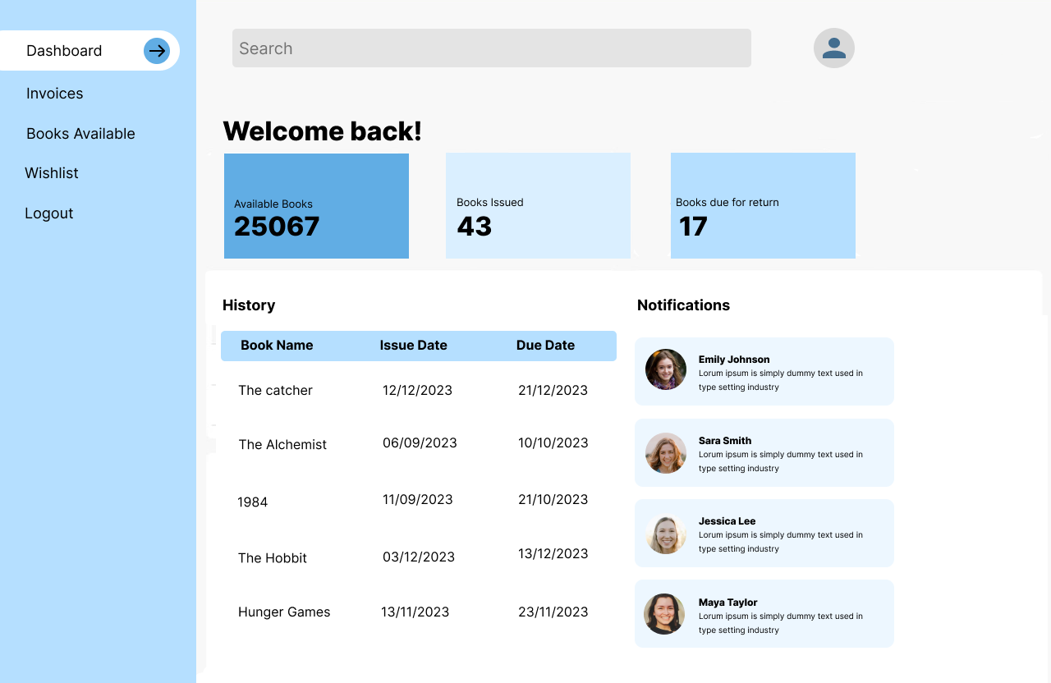
User Profile

Slide 16
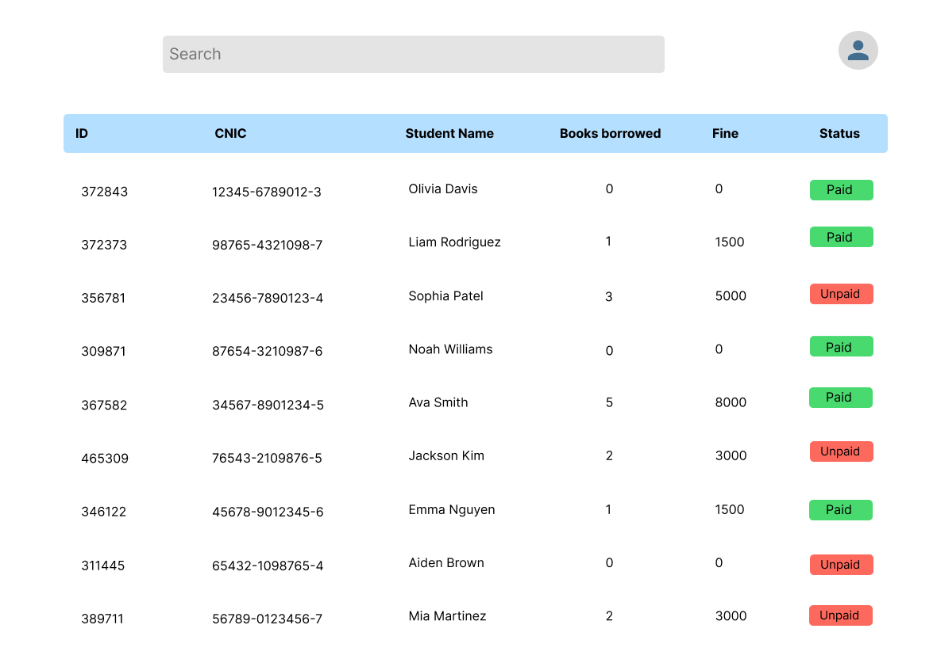
User Logs

Slide 17
Non-Functional Requirements
1
Security 🔒
2
Reliability
Implement robust security measures to protect user data, prevent unauthorized access, and ensure the confidentiality of library resources.
Our system is your reliable friend, ensuring data safety with regular backups. The storage is highly dependable, with minimal downtime even during peak usage.
3
Maintainability 🛠
4
Binary Compatibility
Design the system with a modular and extensible architecture, making it easy to maintain, update, and integrate with other library systems or APIs.
Our system is compatible with Windows 10, Windows 11, and MacOS versions from Catalina to Monterey. We commit to regular updates to ensure smooth usage, even with future operating system releases..

Slide 18
Use Case
Use Case Name
Catalog Management
Actor(s)
Librarian
Description
Librarians can add, update, or delete resource records.
Preconditions
Librarian is authenticated.
Postconditions
Catalog is updated.
Main Flow
Librarian logs in → Accesses catalog →Modifies records.
Alternative Flows
None.
Data
Resource information, librarian credentials.
Stimulus
Librarian decides to modify the catalog.

Slide 19
Use Case Name
Borrowing Resources
Actor(s)
Users
Description
Users can borrow physical resources. The system maintains due dates and manages renewals
Preconditions
User is authenticated and account is in good standing.
Postconditions
Resource is marked as borrowed. User’s account is updated with due date.
Main Flow
User selects resource → System checks availability → Process transaction.
Alternative Flows
If resource is not available, offer to reserve it
Data
Resource details, user account information
Stimulus
User selects a resource to borrow

Slide 20
Use Case Name
User Registration and Authentication
Actor(s)
Users
Description
Users can create a new account and log in to access the system
Preconditions
User is not already registered
Postconditions
User account is created and user can log in
Main Flow
User enters details → System validates data →System creates account.
Alternative Flows
If details are invalid, prompt user to correct them.
Data
User details, login credentials
Stimulus
User chooses to register or log in.

Slide 21
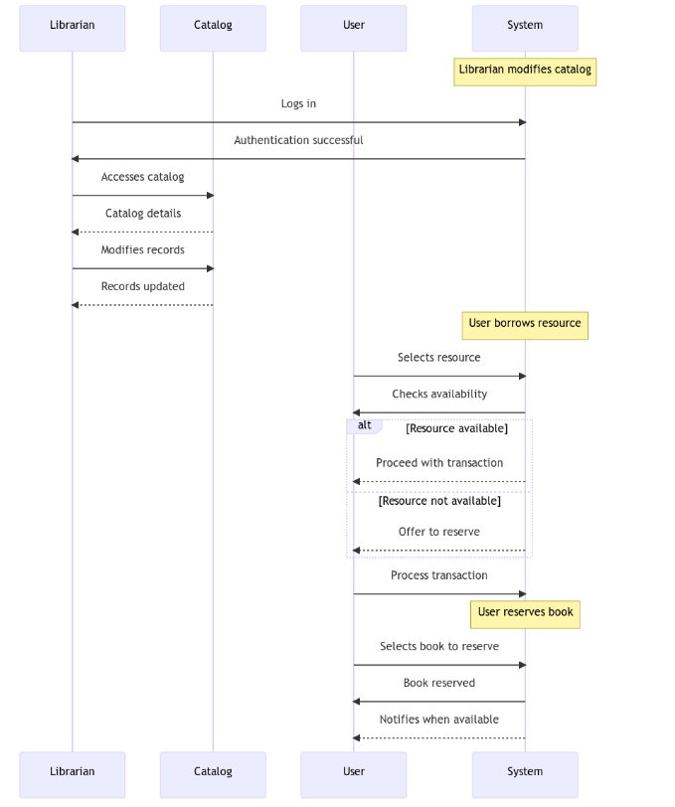
Sequence Diagram

Slide 22
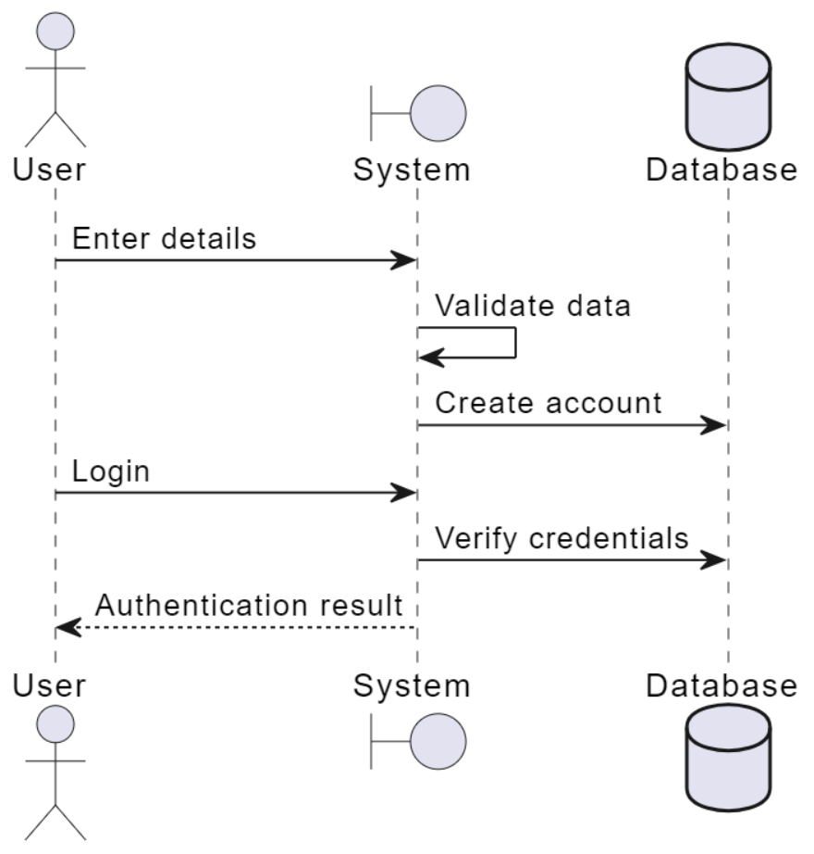

Slide 23
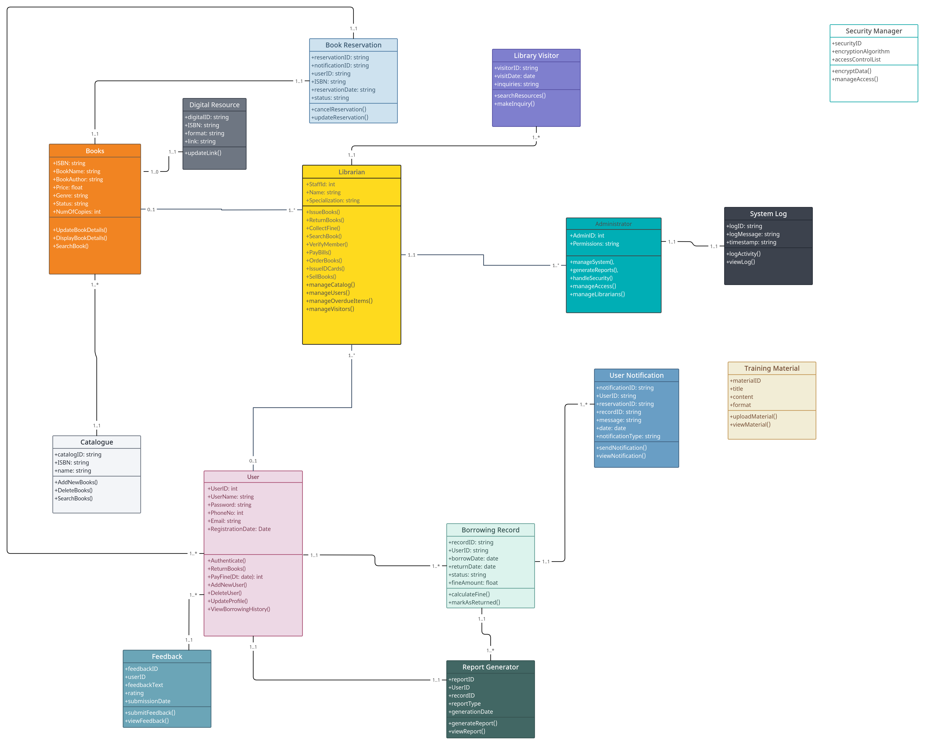
Class Diagram

Slide 24
Budget and Schedule
Expense Category
Estimated Cost (PKR)
Development Team Salaries
500,000
Software Licensing
100,000
Hardware Procurement
200,000
Testing and Quality Assurance
150,000
Maintenance and Support
80,000
Miscellaneous Expenses
20,000
Total Estimated Budget
1,050,000

Slide 25
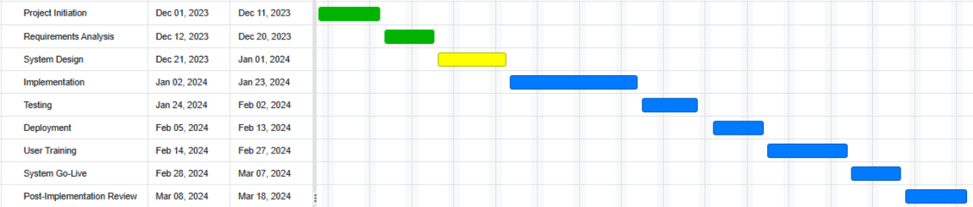
Schedule

Slide 26
Interviews
Interviewed Librarians
NUST Library:
Semi-automated system.
Gathering insights on current challenges and desired enhancements.
Punjab Library:
Completely manual system.
Exploring requirements to transition to an automated system.
Objective
Interviews conducted to gather comprehensive requirements for the development of a tailored Library Management System.

Slide 27

Conclusion & Questions

